Slide 1

Digital Commons for Common Good: Exploring Common Building Blocks with LFEnergy
Tony Shannon
Head of Digital Services
Office of Government Chief Information Officer
Government of Ireland
October 2022 @frectally

Slide 2


Slide 3

Stories from the Frontline

Slide 4


Stories from the Frontline
Notes:
Tony
EP & EM in the NHS
4hr standard success & victim of success
Pressure continues
Need to work smarter > harder
New ways of working

Slide 5
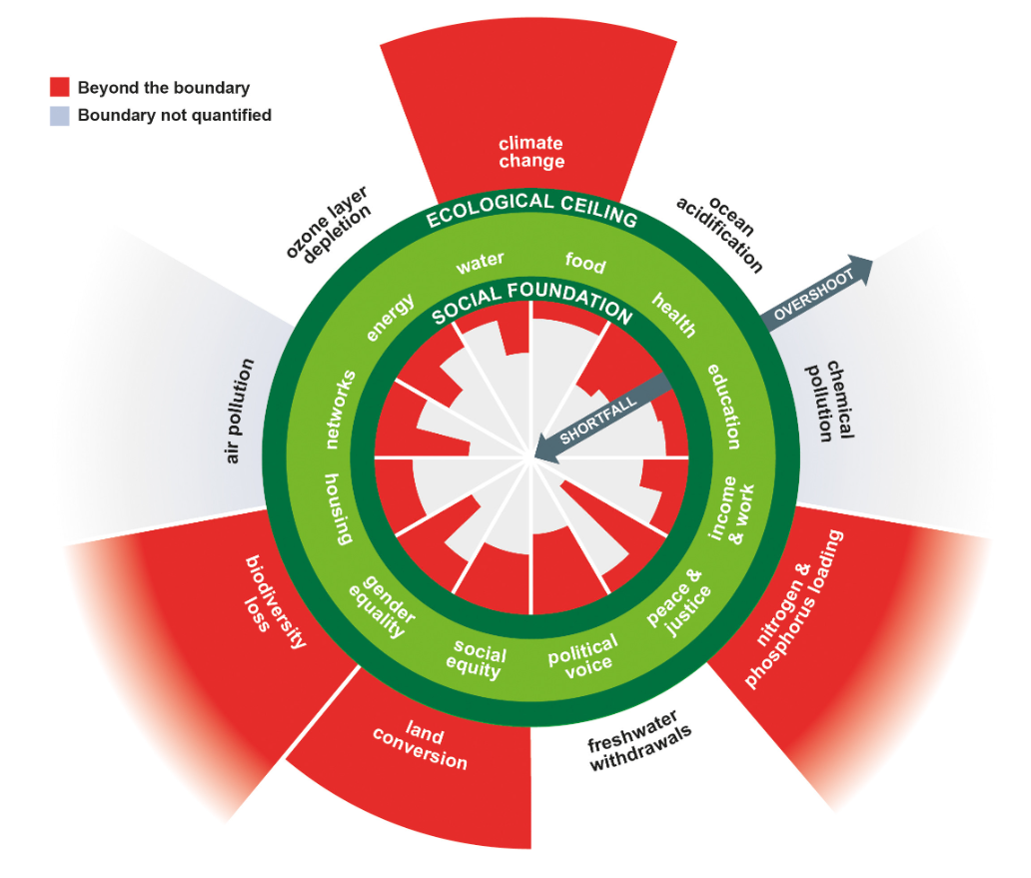
Learnings: 21st Century SocioEconomics

Slide 6
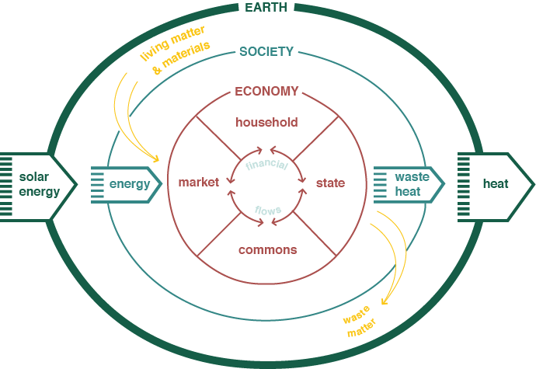
Learnings: Household- State- Market- Commons

Slide 7






Action: Towards a Digital Commons
Icons designed by Freepik.com
User Interface
Information Exchange
Data Repository

Slide 8




Slide 9

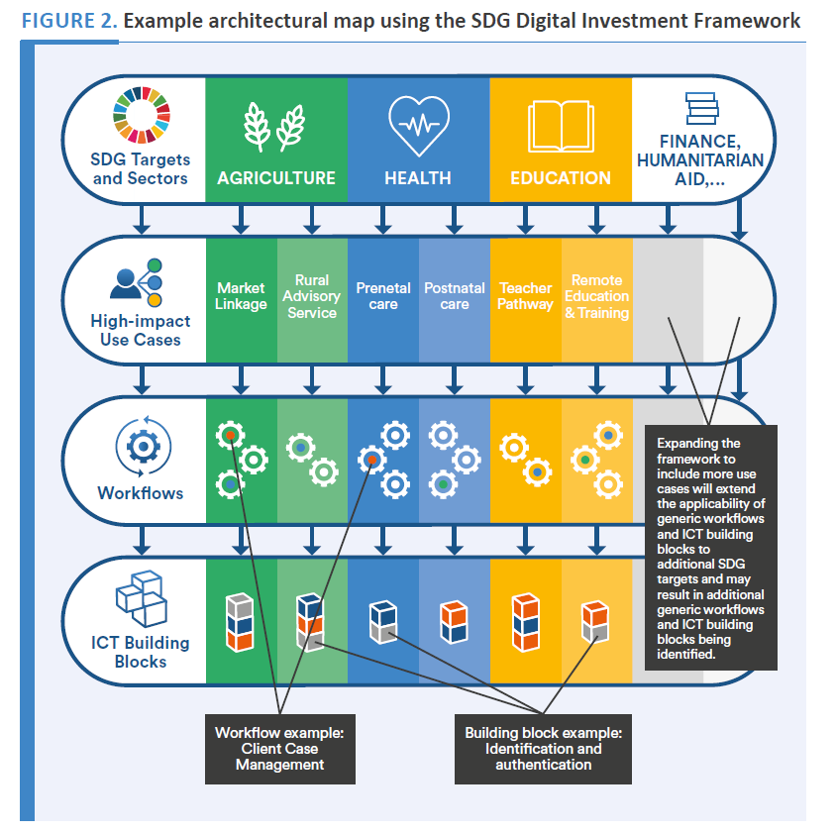


Slide 11
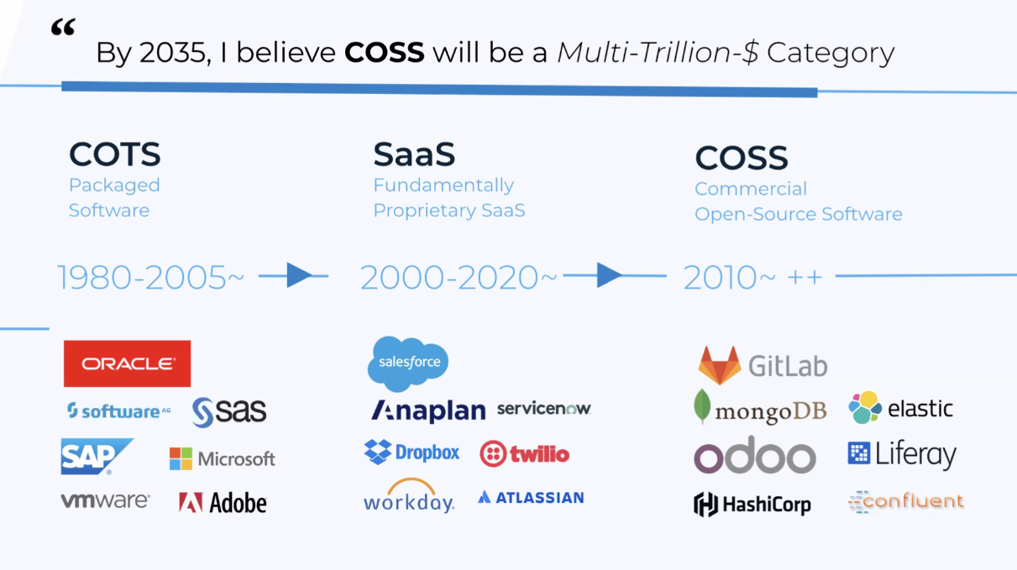
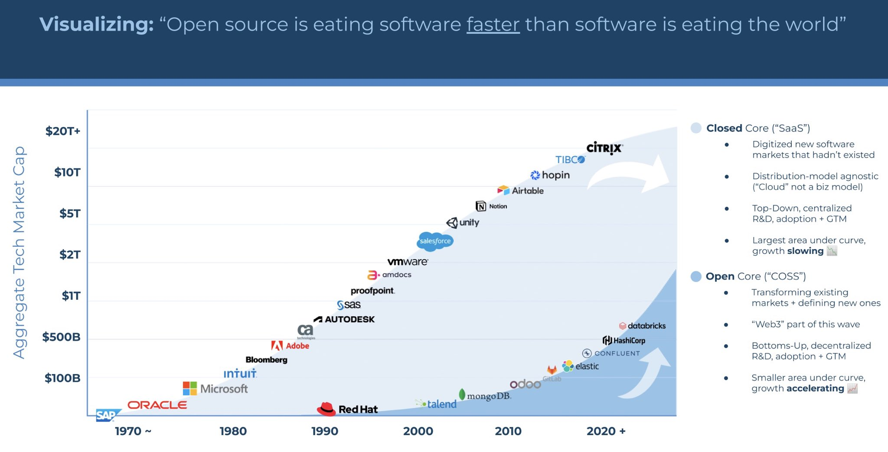
Common Components

Slide 12
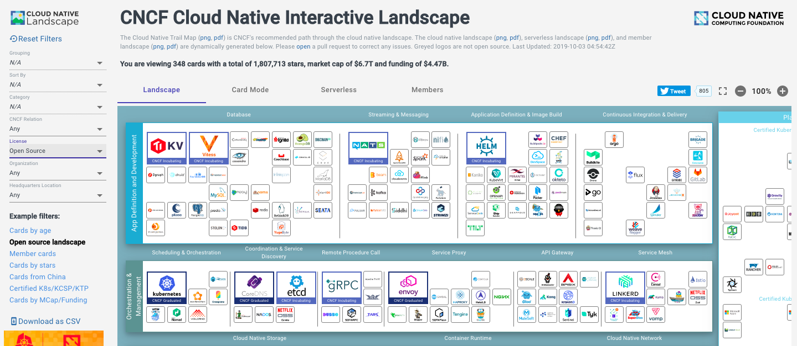

Components in the Cloud
Ripple Foundation C.I.C Ltd
Private & Confidential

Slide 13
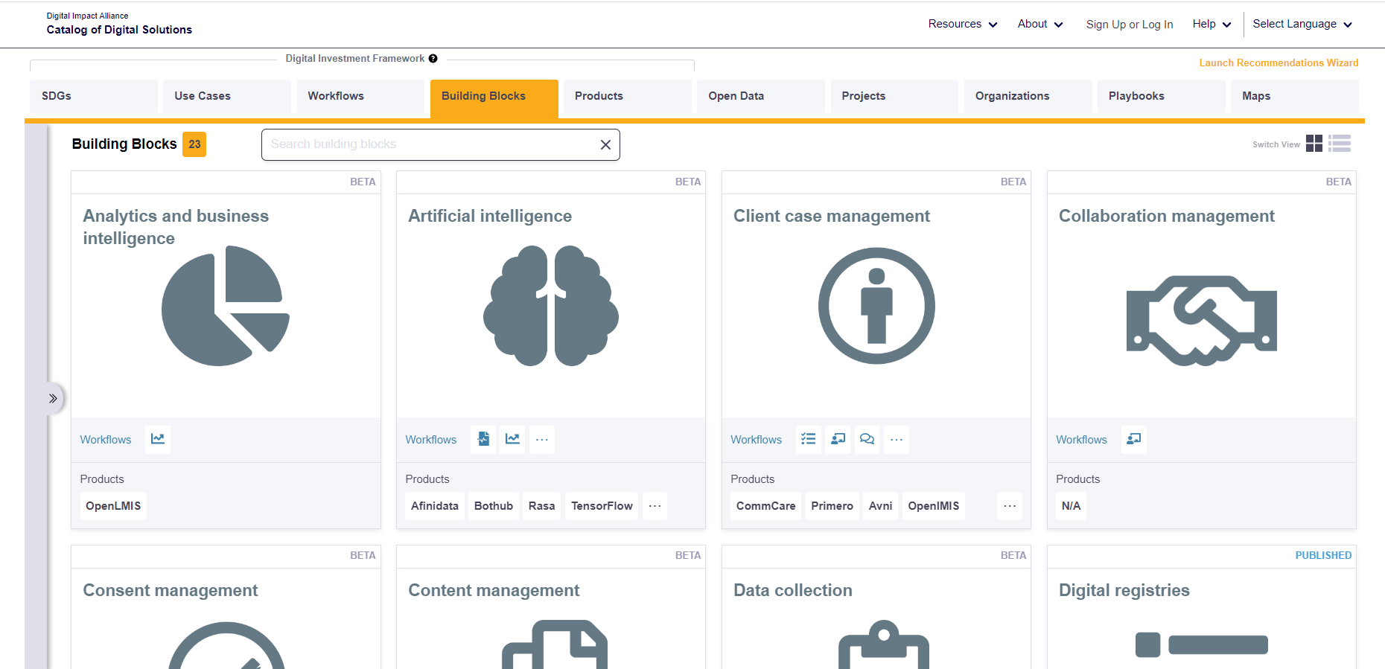

Common Components in the Commons

Slide 14
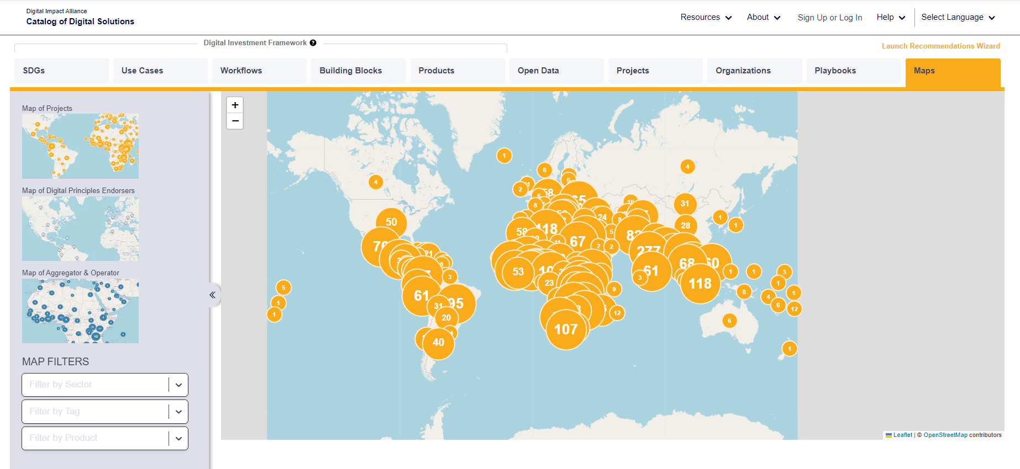

Slide 15
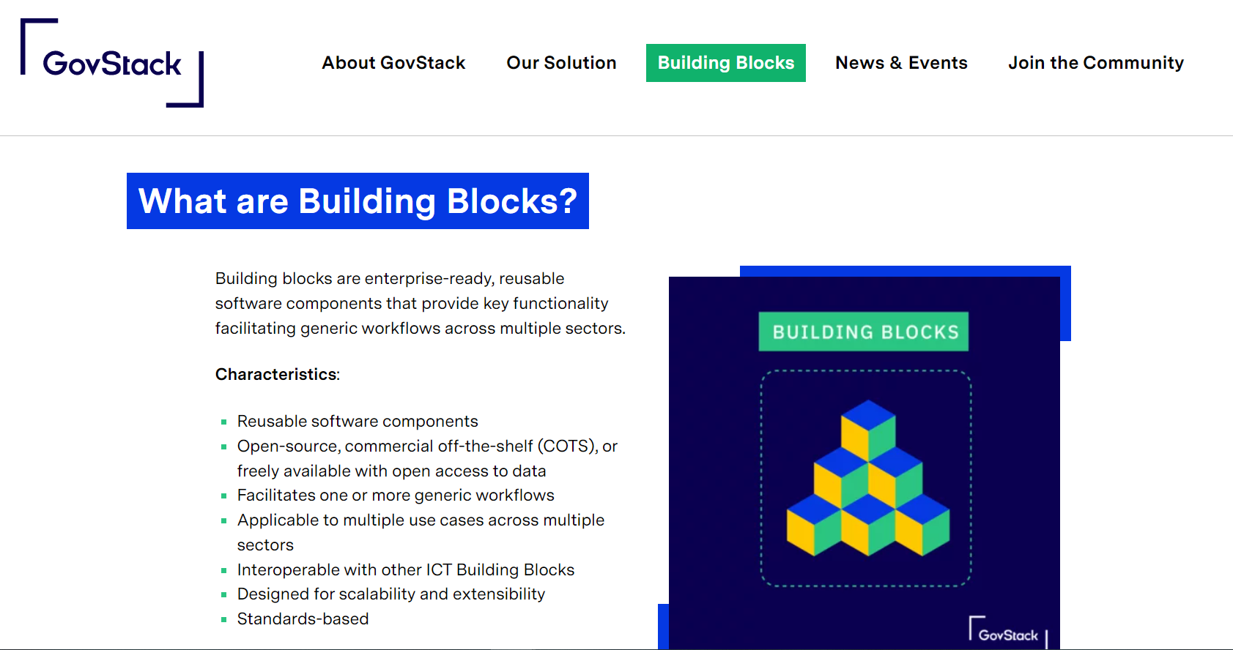


Slide 16

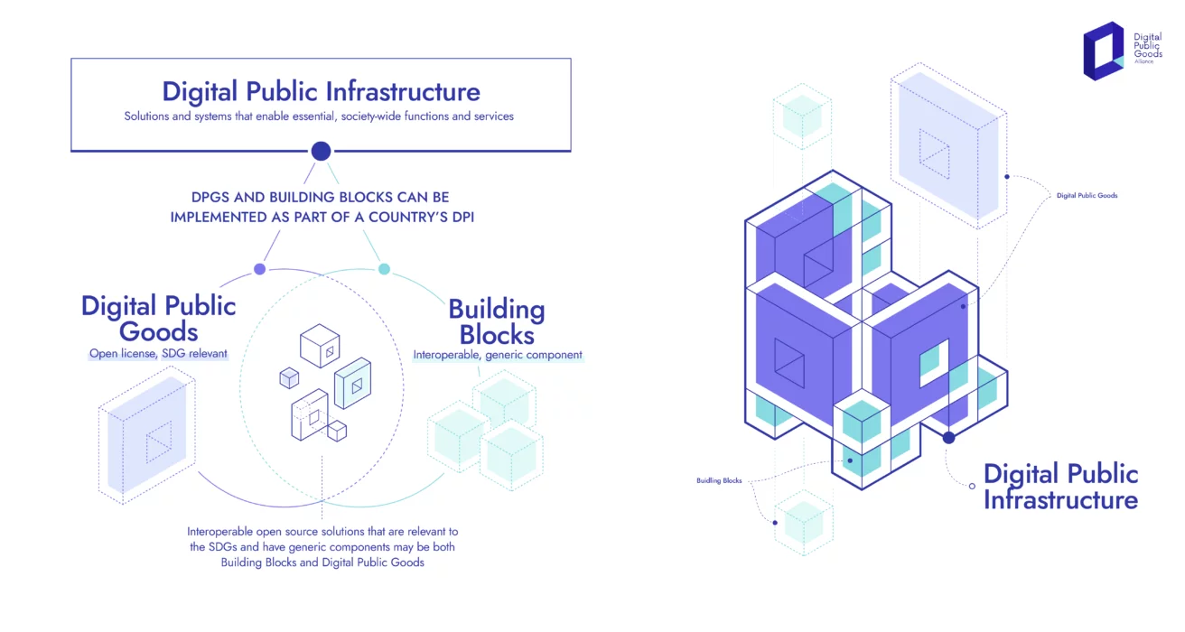

Slide 18

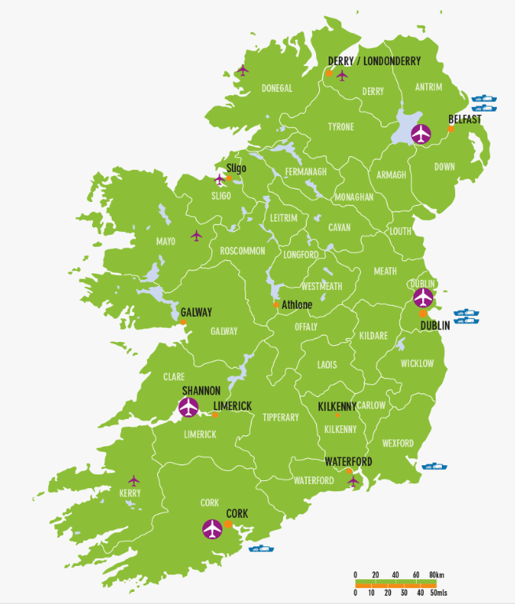


Slide 19
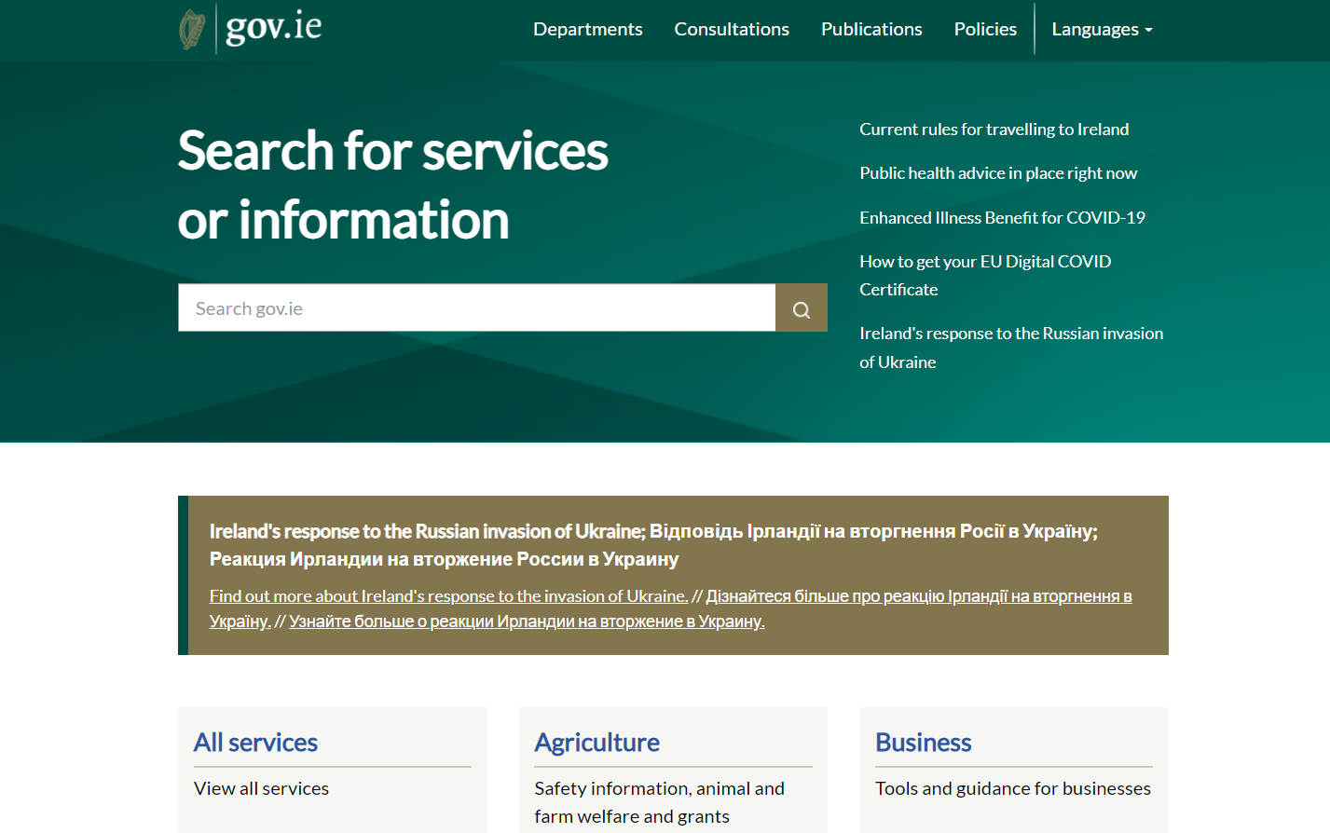
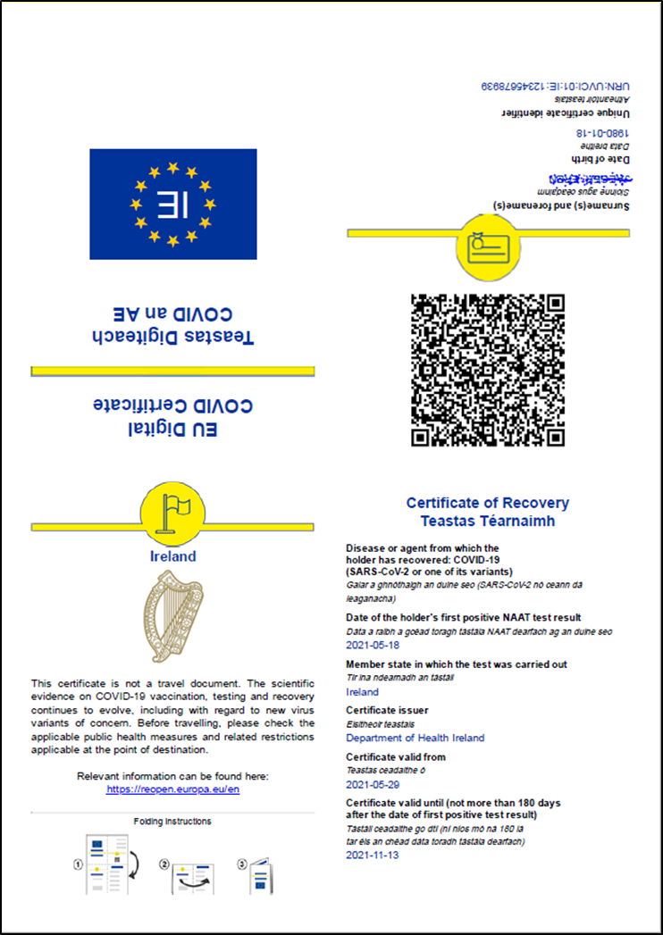

Slide 20
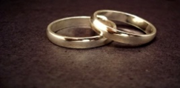
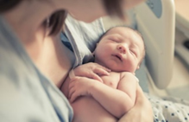

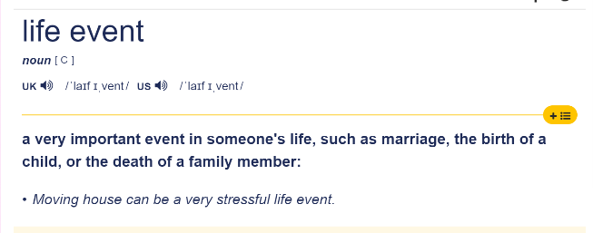

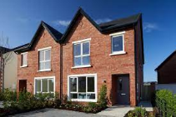
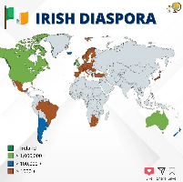



Slide 21



Life Events Service
Digital Identity
Content Management
Data Collection
Case Management
Messaging
Information Mediator
Analytics

Slide 22
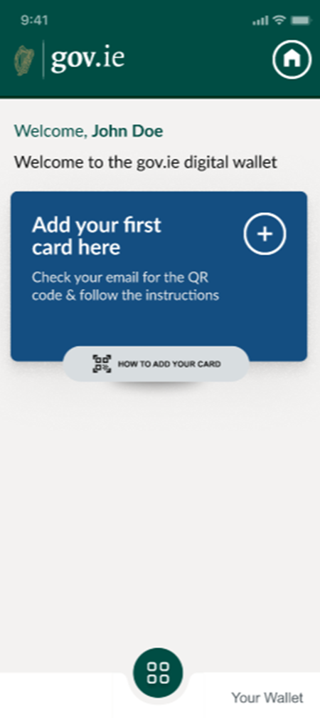
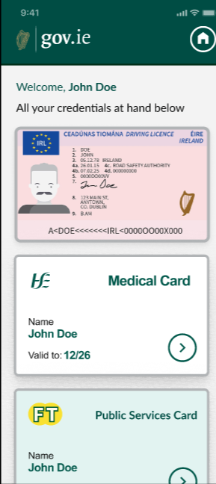
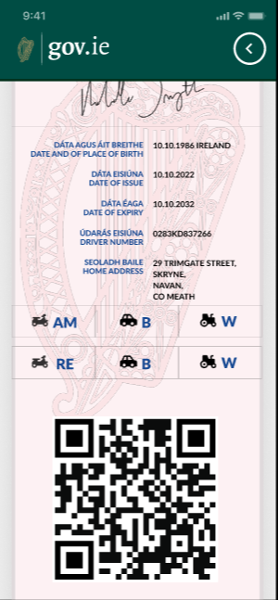

Slide 23

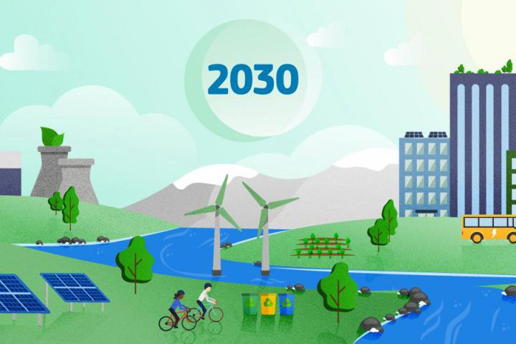
Towards 2030: Decade of Digital & Green
9

Slide 25
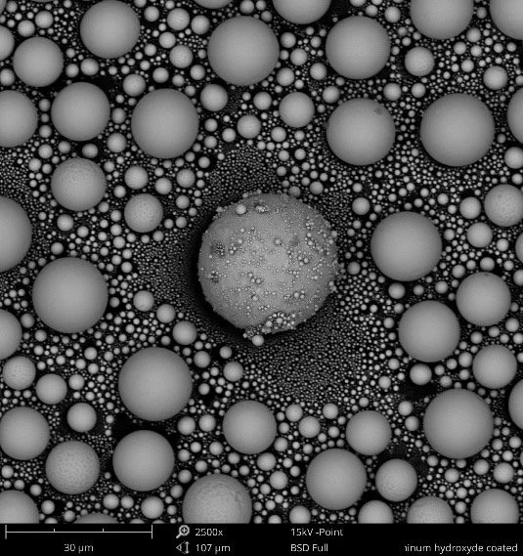
Exploring Patterns

Slide 26
Common Goal: 21st Century SocioEconomics

Slide 27
Common Ground: Household- State- Market- Commons

Slide 28
Common Components in the Commons

Slide 29
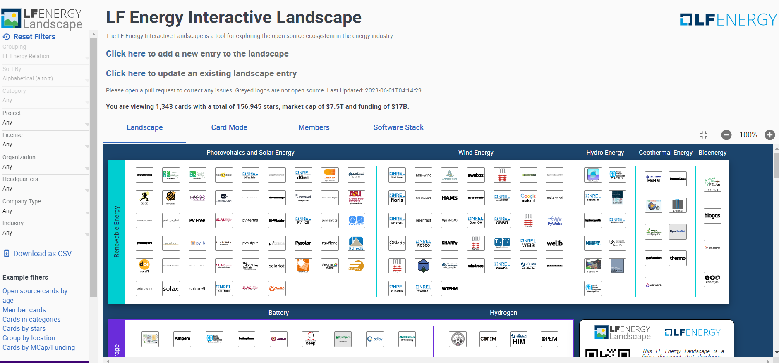
LF Energy Landscape

Slide 30
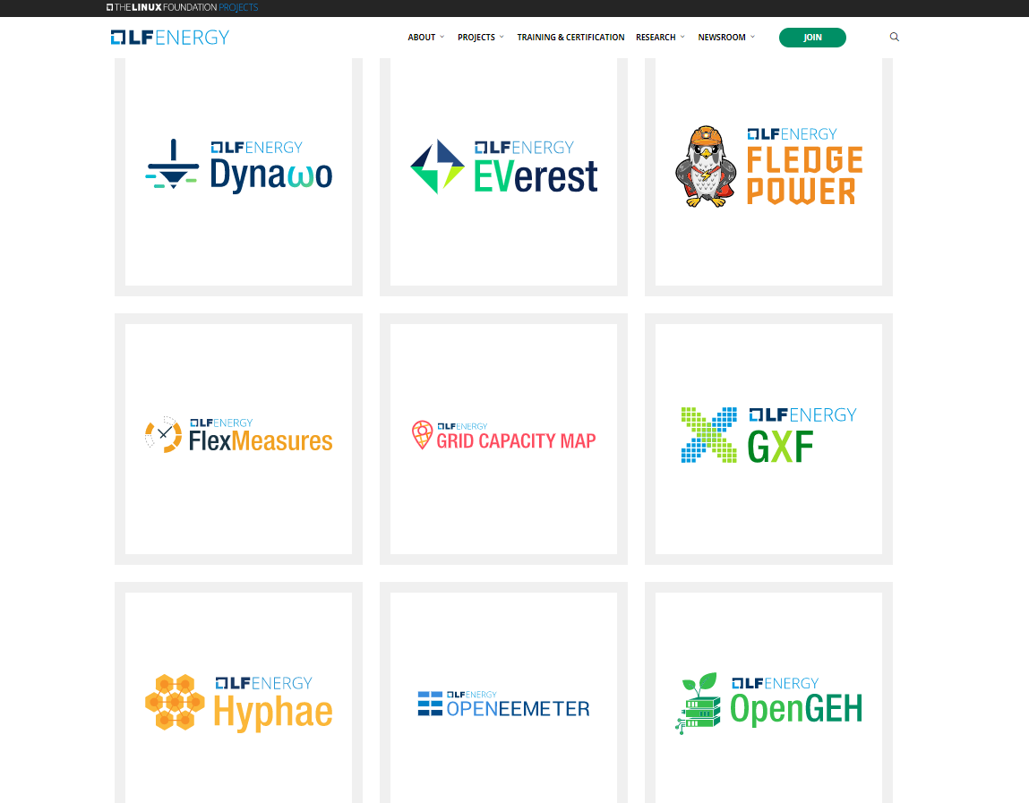
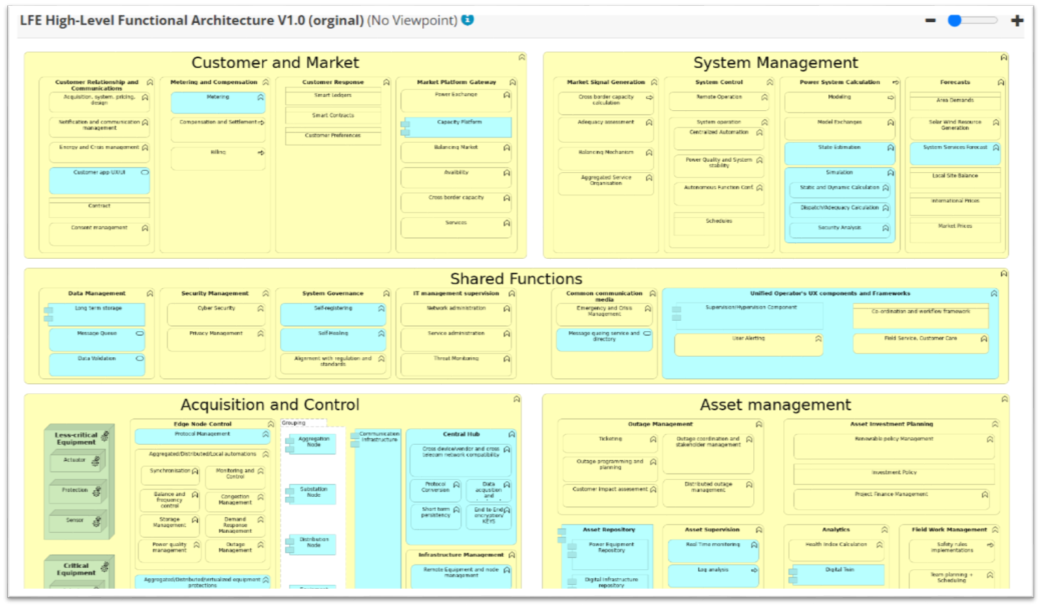
LF Energy Projects & Architecture

Slide 31
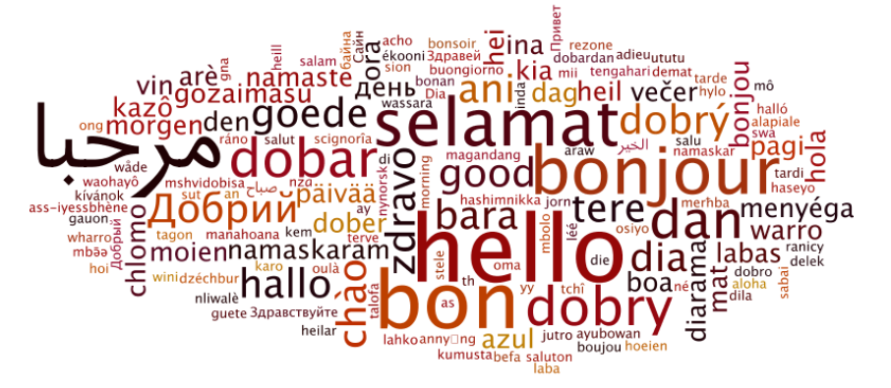
Patterns & the Arts

Slide 32
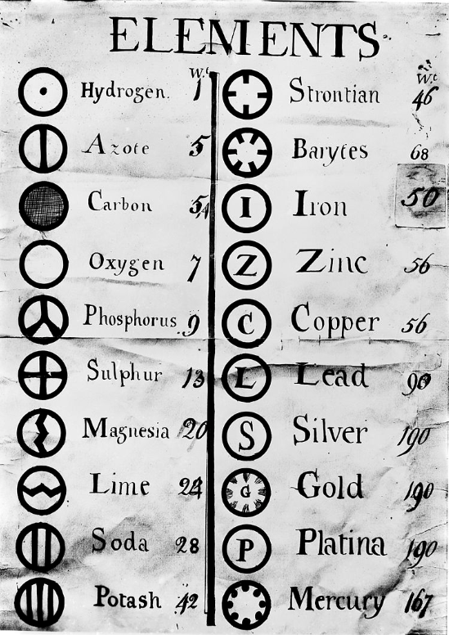
Patterns & the Sciences

Slide 34
Patterns & Building Blocks

Slide 35
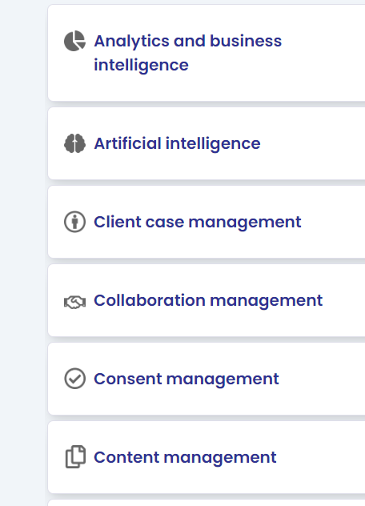
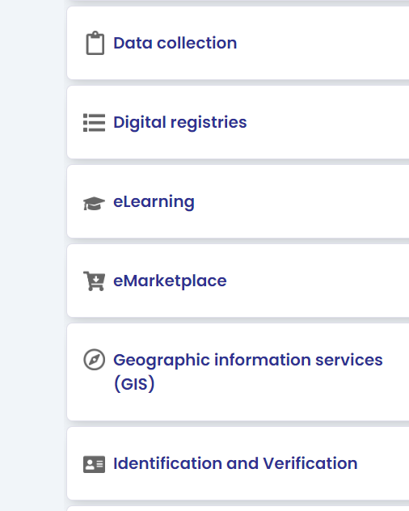
Building Blocks - for the people

Slide 36
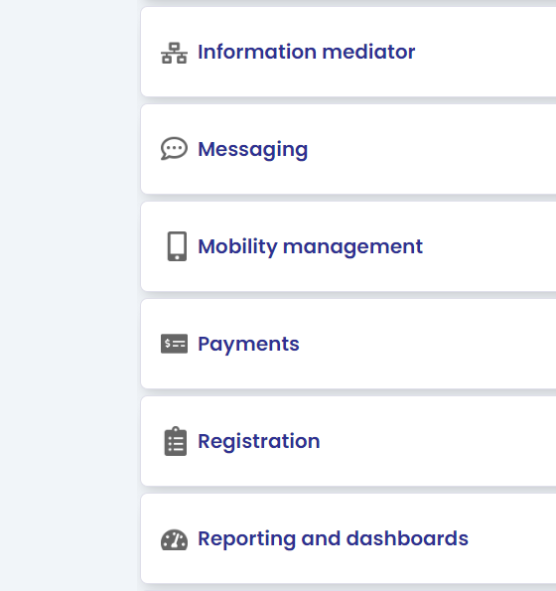
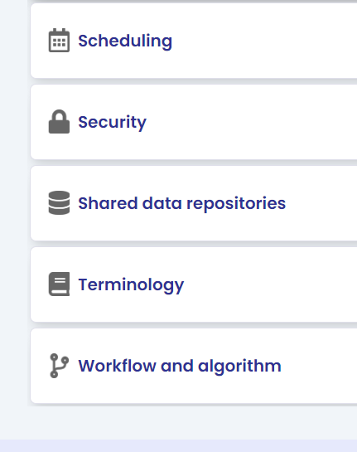
Building Blocks - for the people

Slide 37
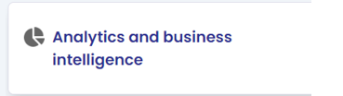

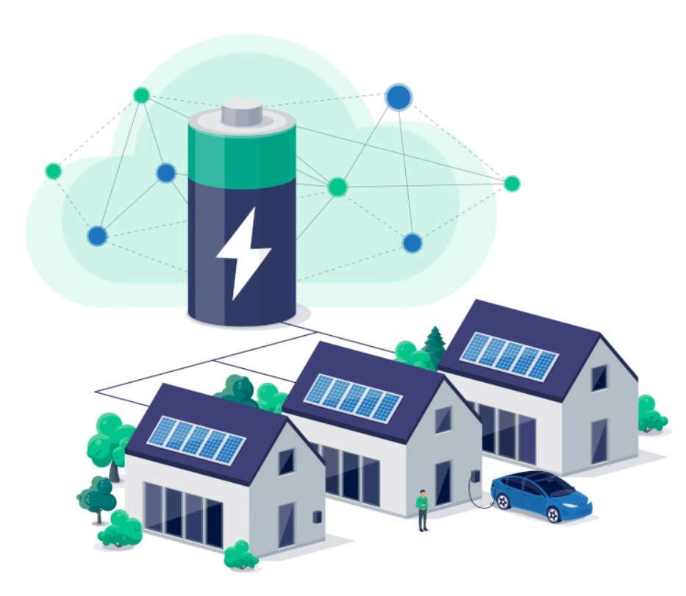

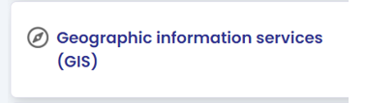





Building Blocks - for the planet?

Slide 38
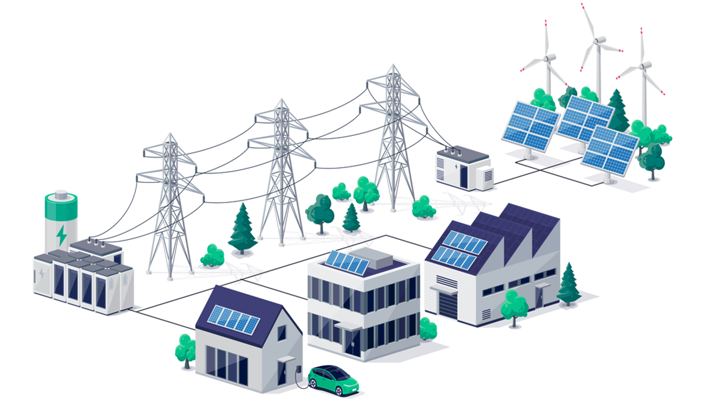
Building Blocks - for the planet?

Slide 39

Building Blocks - for the planet?

Slide 41

Thank you
Tony Shannon
Head of Digital Services
Office of Government Chief Information Officer
Government of Ireland

Slide 43
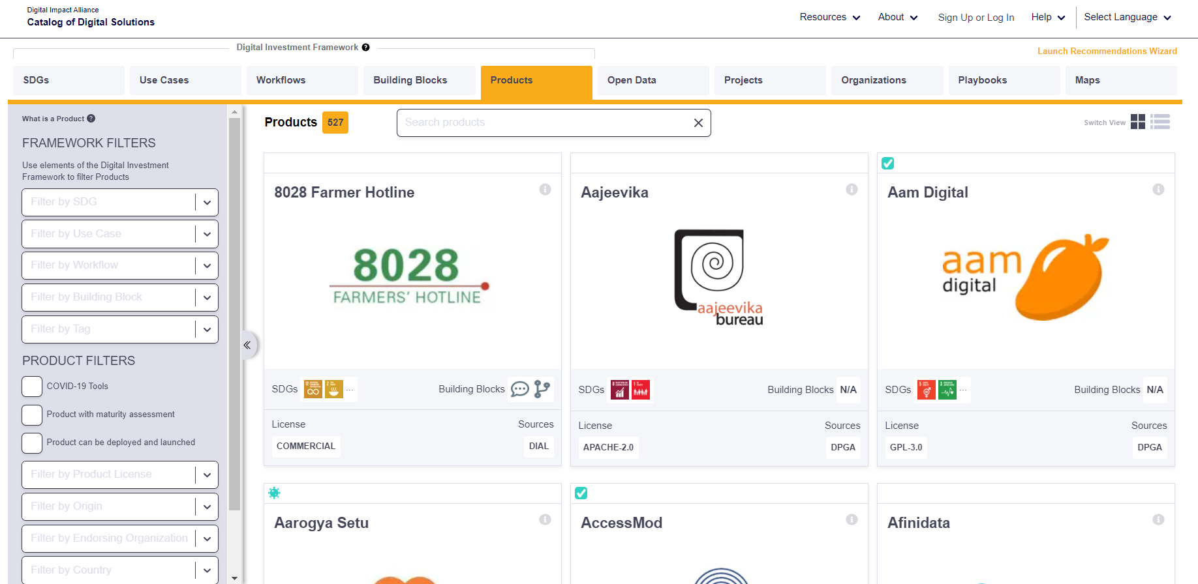

Slide 44
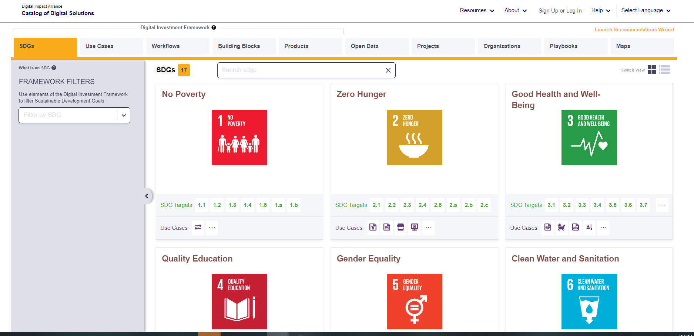


Slide 45
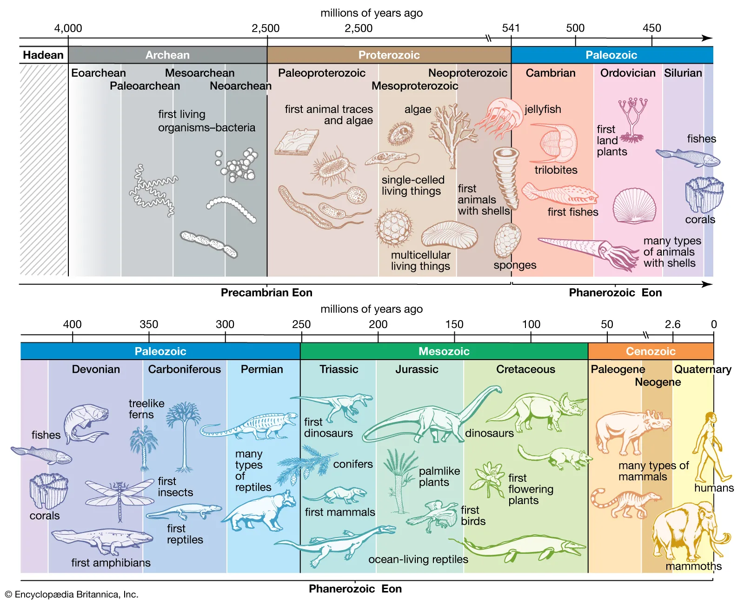
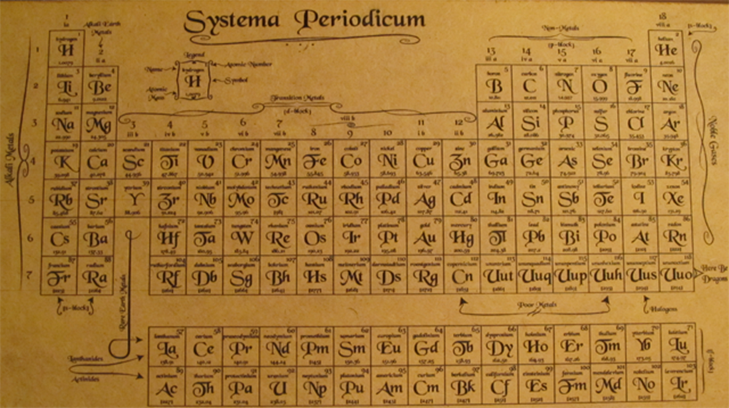

Slide 46
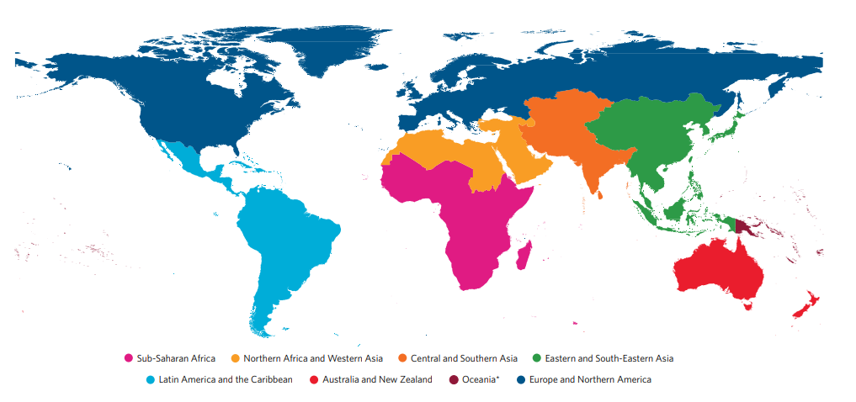
North- South- East- West

Slide 47
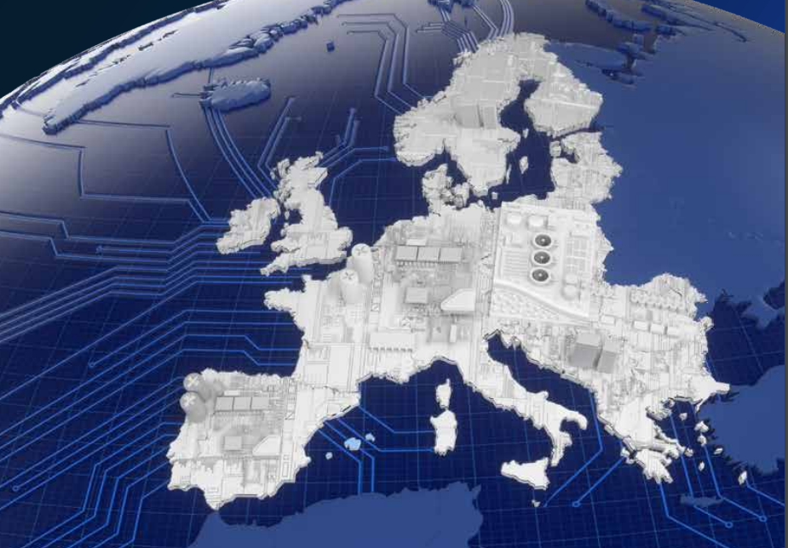

Slide 49
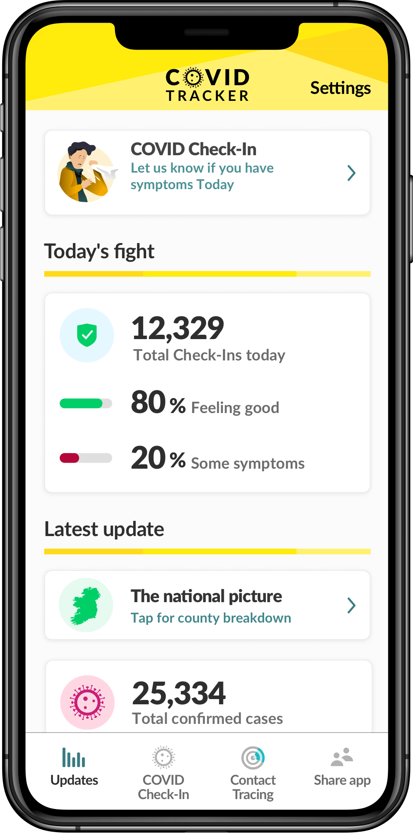


Slide 50
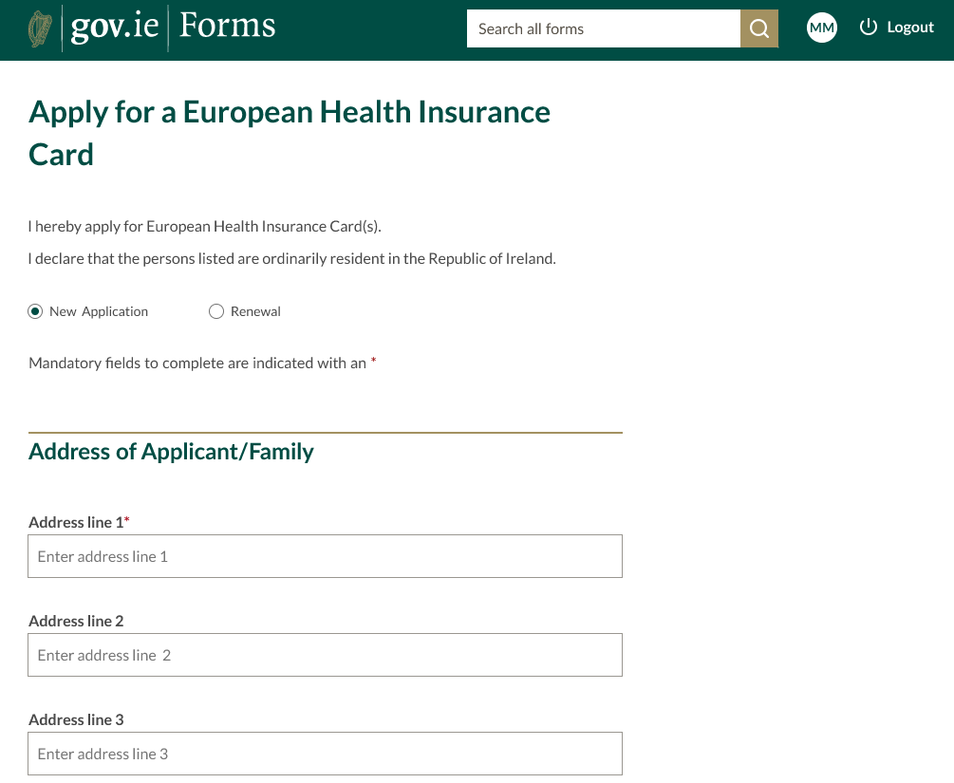

Slide 51
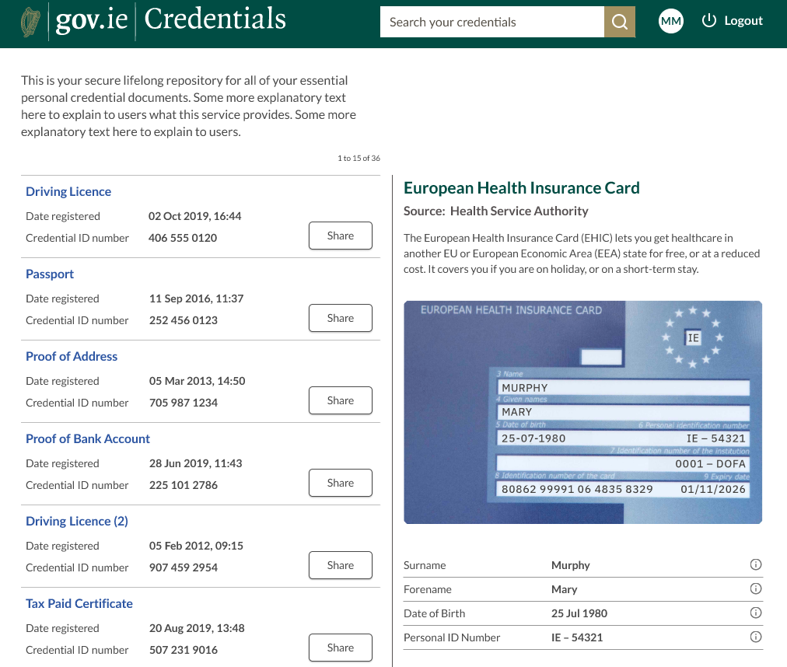


Slide 52

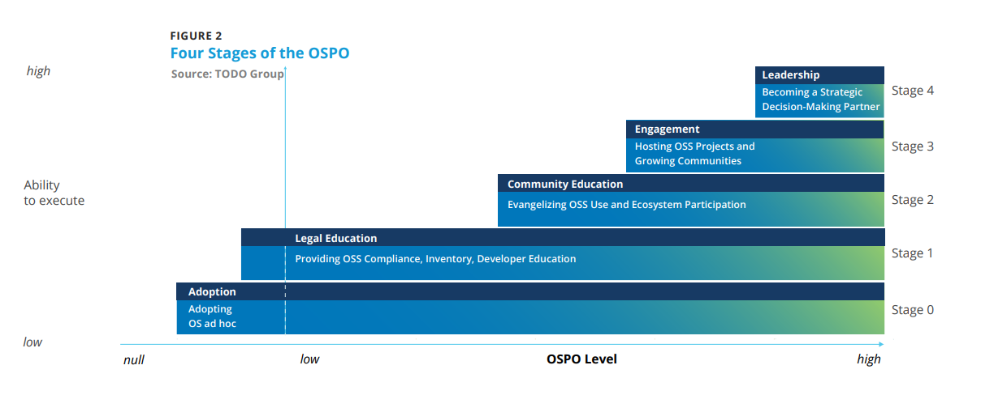
Common Purpose: Common Ground?

Slide 53
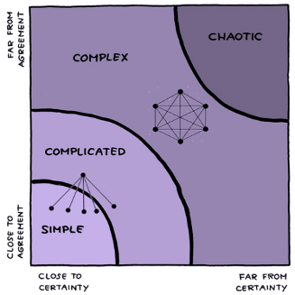

Slide 55
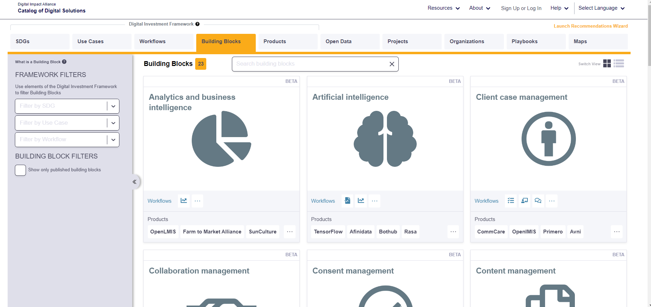

Slide 56
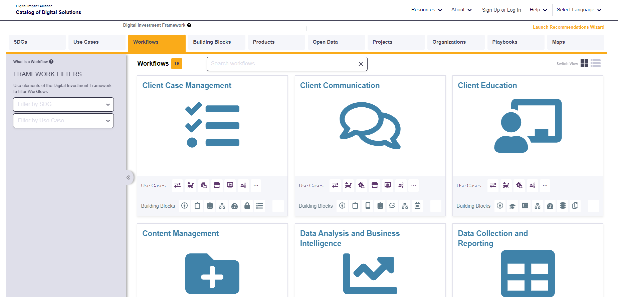

Slide 57
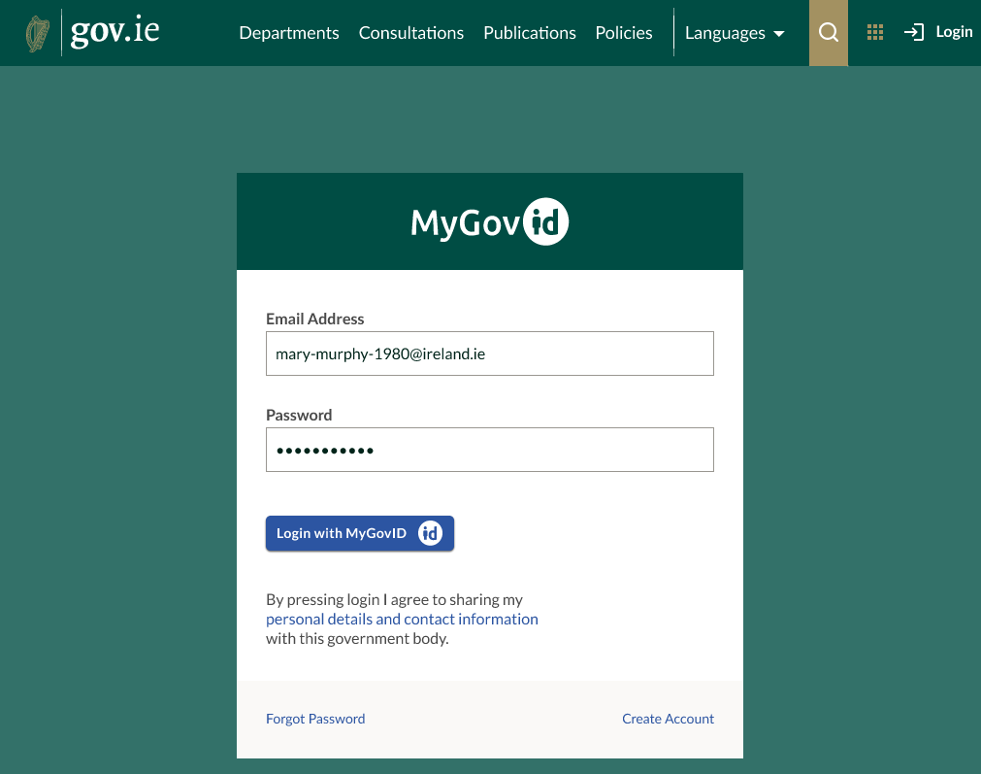

Slide 61



